Slide 1
Business & Location select in Toronto
COURSERA IBM DATA SCIENCE CAPSTONE

Slide 2
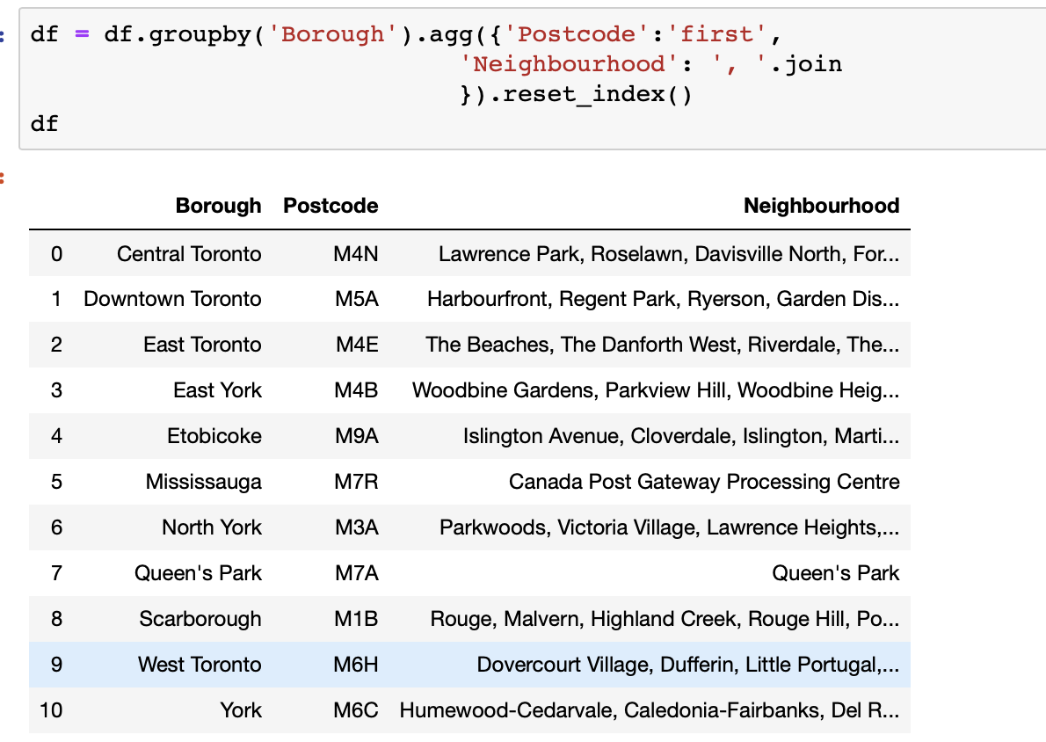

Data input
Toronto neighbor data

Slide 3
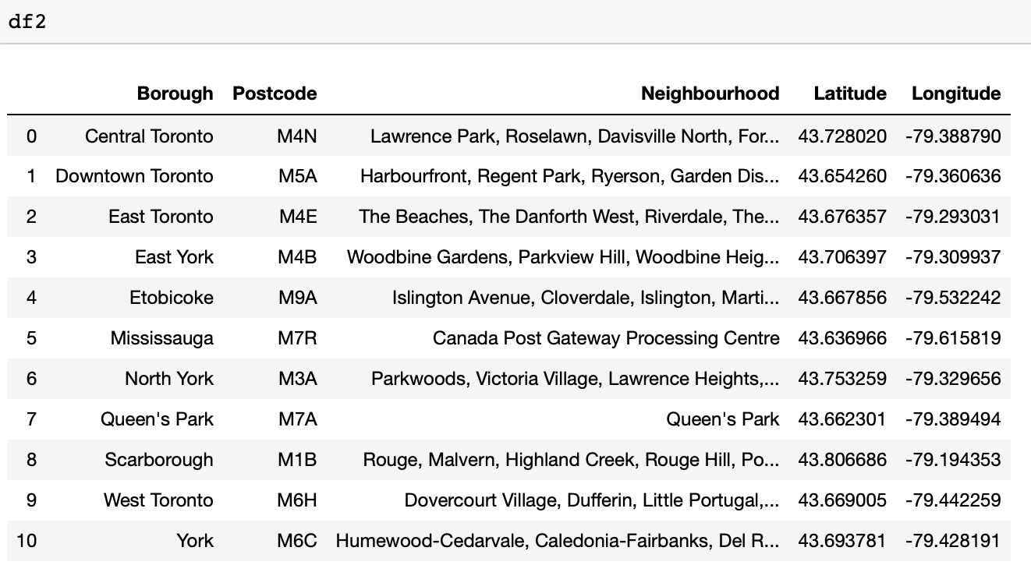
dAta processing with lat and long

Slide 4
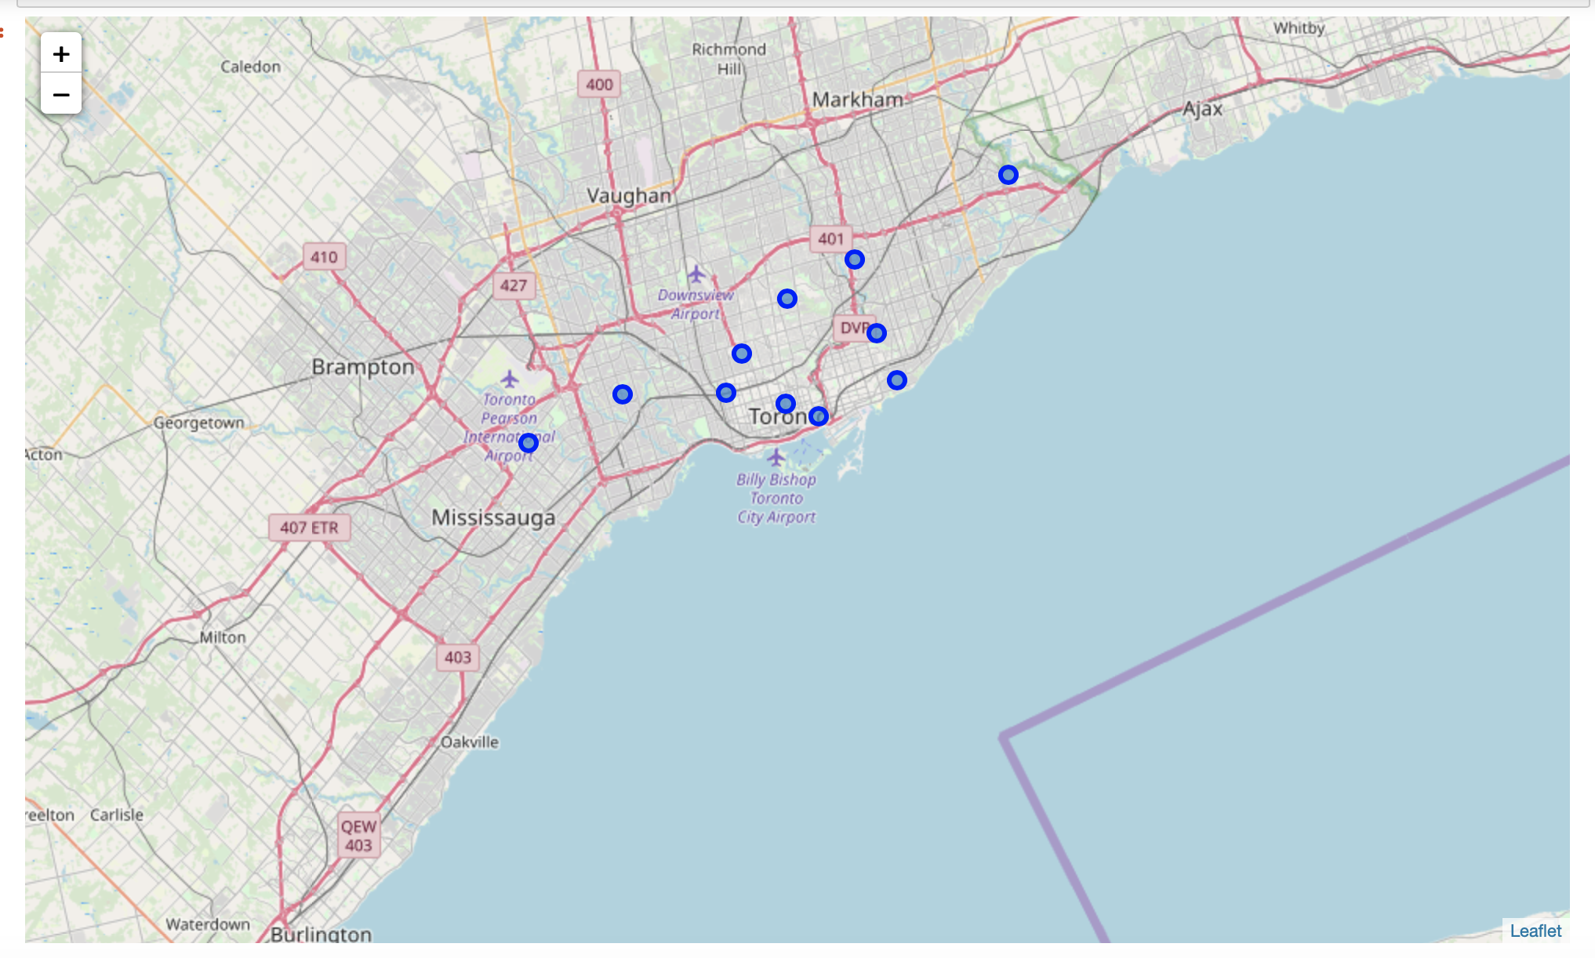
Data visualization with map for neighbor

Slide 5
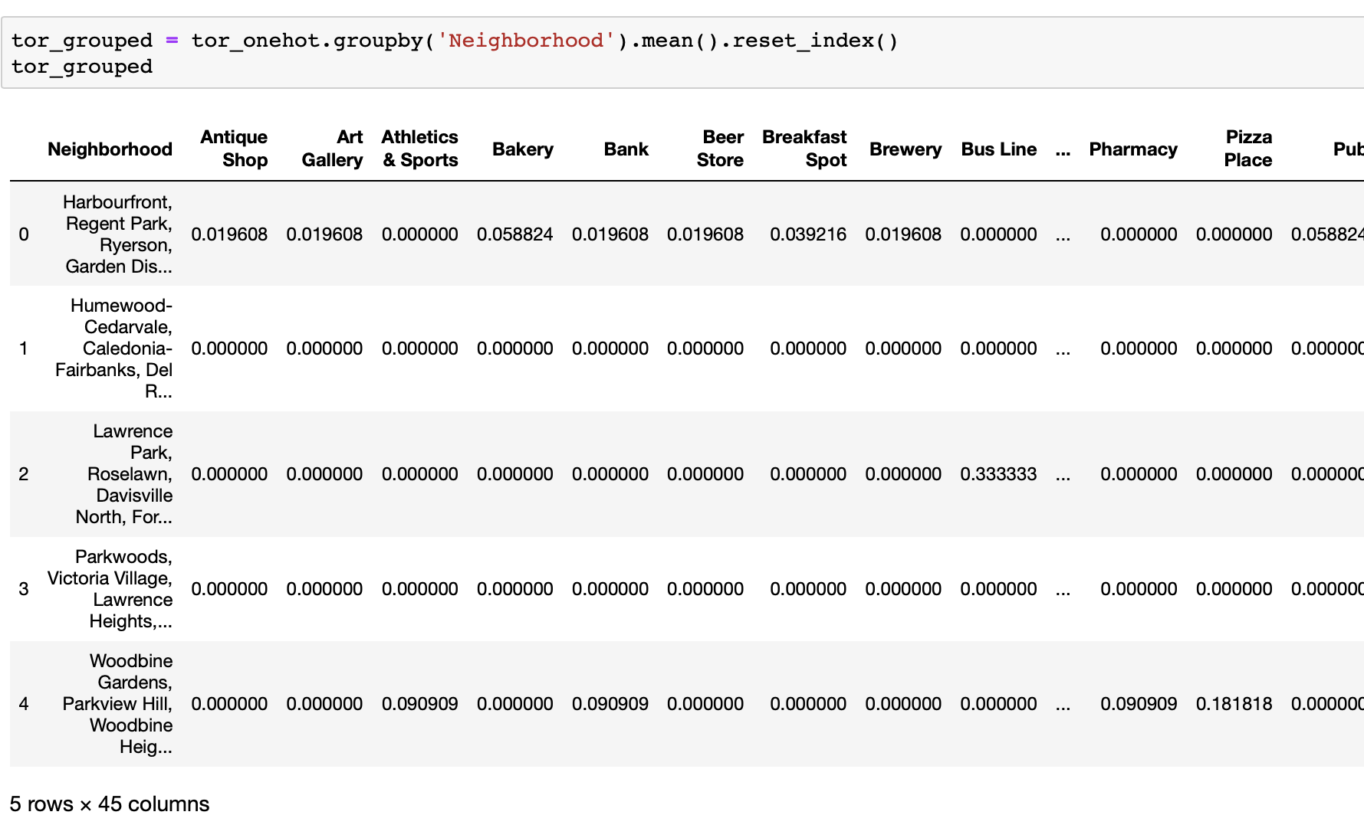
Venues generation for neighbors

Slide 6
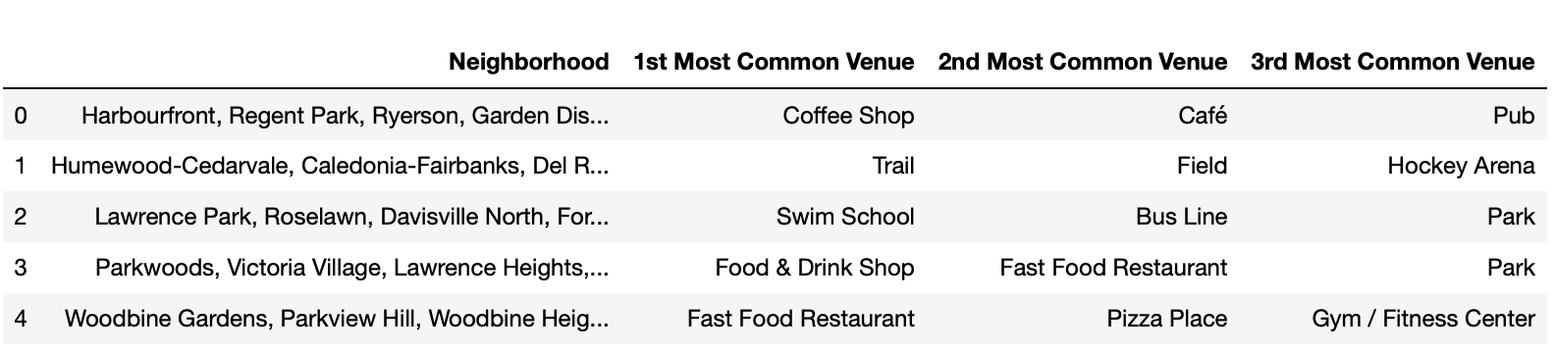
Rank for different venues

Slide 7
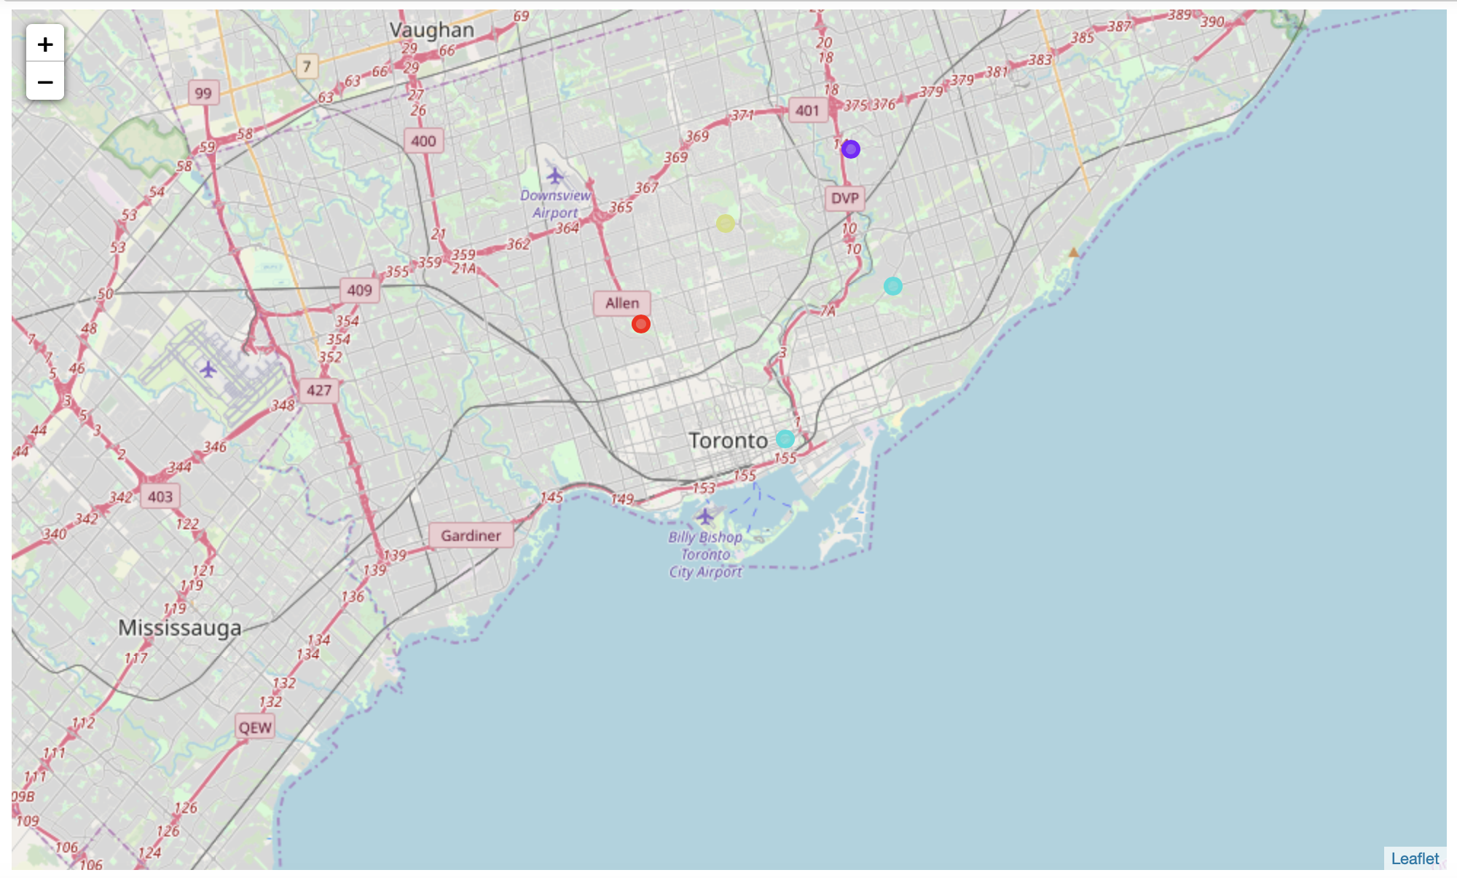
Visualization with cluster analysis in map

Slide 8

Thanks

